Slide 1
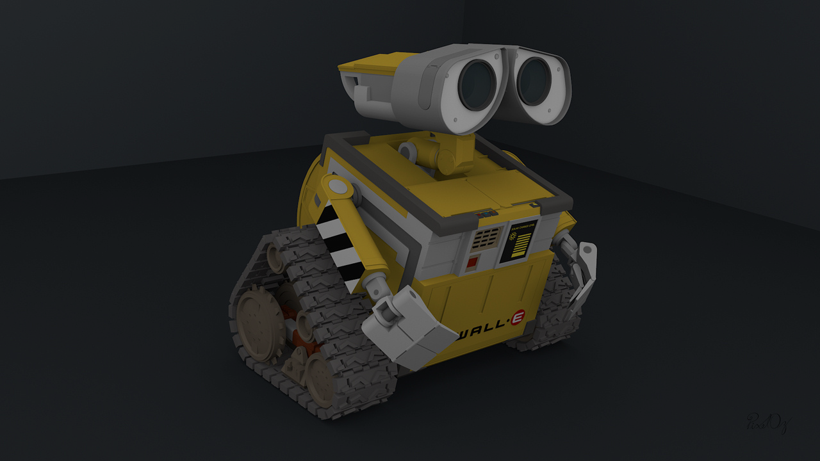

COMP702 – MSc Project To Build a video tutorial for robot obstacle avoidance in WebotS
Karan Sonik - 201599602
Supervisor – Terry Payne
Second Marker – Unassigned

Slide 2
Project Description
The objective of this project is to create an instructional video tutorial that demonstrates the process of developing and using obstacle avoidance algorithms. The tutorial will focus on implementing well-known algorithms such as Bug 1 and Bug 2, which are commonly used for navigating around obstacles.

Slide 3
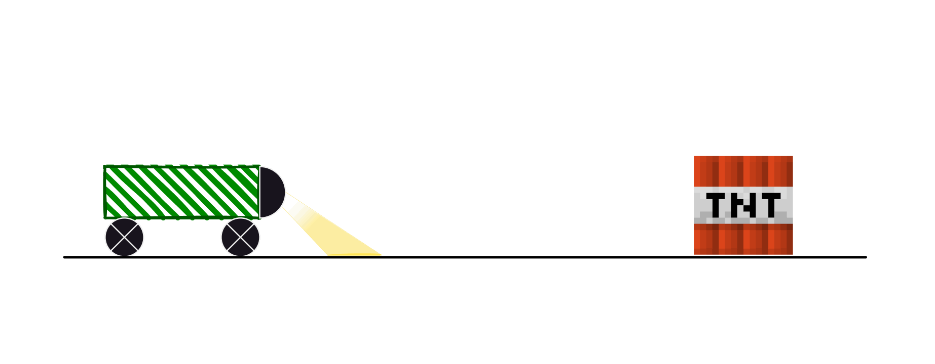
Aims & Objectives
Project has 3 key milestones –
Test the Bug 1 or Bug 2 algorithms on Webots
Replicate the tests whilst recording, using the OBS Studio software.
Edit the videos using DaVinci Resolve.
Prototype made on Figma [9]

Slide 4
Key Literature & Background Reading
Studying the Bug algorithms, and their path finding and object detection abilities intensively.
Module COMP329 - Autonomous Mobile Robotics, https://canvas.liverpool.ac.uk/courses/59631,
Documentation of Webots is given on https://cyberbotics.com/doc/guide/introduction-to-webots, is to be referenced throughout the course of this project.
Documentation of DaVinci Resolve is given on https://documents.blackmagicdesign.com/UserManuals/DaVinci-Resolve-17-Beginners-Guide.pdf.

Slide 5
Development and Implementation Summary
Summarized in 3 phases –
Phase 1: Reading on Robotics, Webots, and DaVinci Resolve.
Phase 2: Practice, practice, and more practice!
Phase 3: Replicate the solutions achieved but whilst recording,
Finally, edit and add graphics to the videos

Slide 6
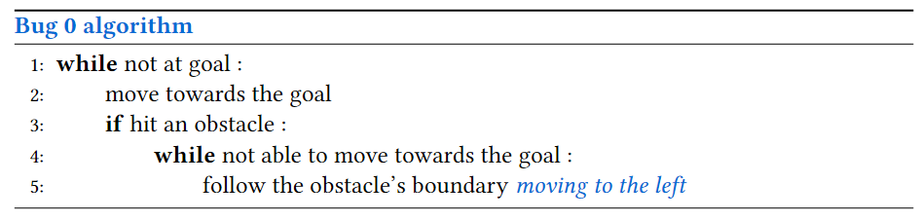
Development and Implementation Summary
Let’s see the Bug 0 algorithm –
Bot starts moving towards the goal
Finds an obstacle in front of it
Turns left and follows the boundary
Although very simple, not reliable.

Slide 7
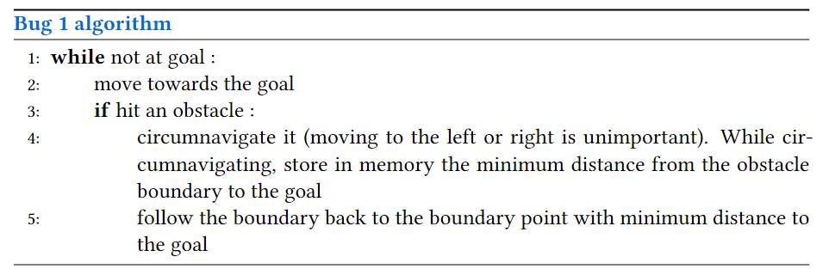
Development and Implementation Summary
Now, let’s dissect the Bug 1 –
Bot starts moving towards the goal
Faces an obstacle in front of it
Use backtracking to find new routes
Advantages – inbuilt memory, will reach its destination (*given time and resources), and backtracking.

Slide 8
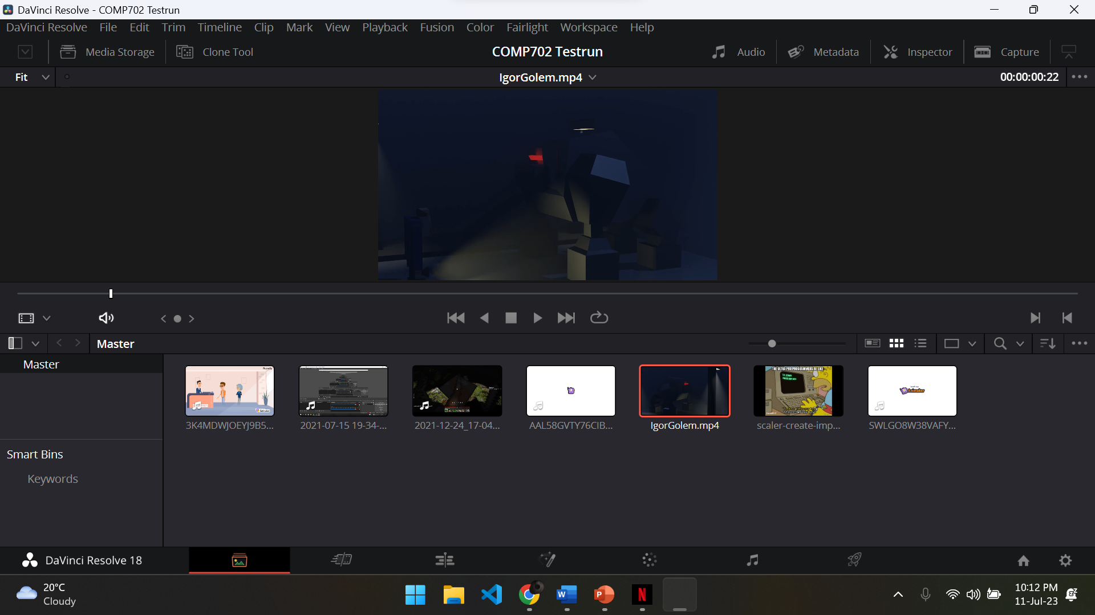
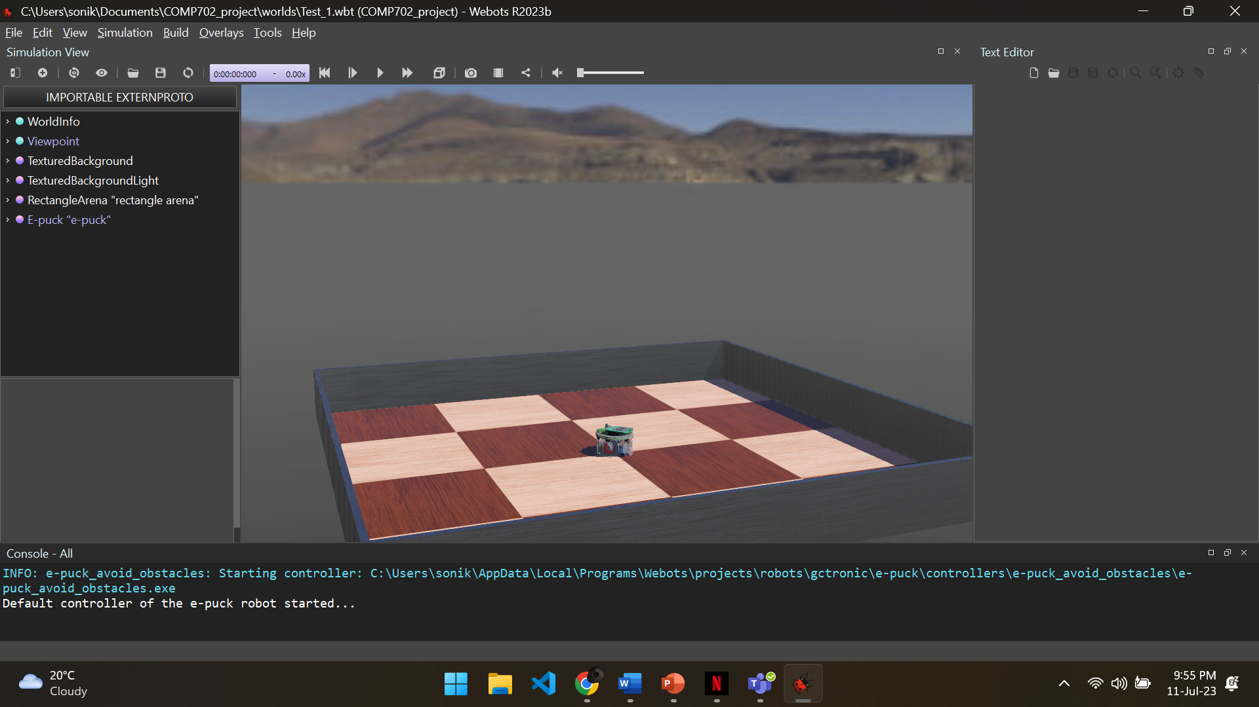
User interface Mockup

Slide 9
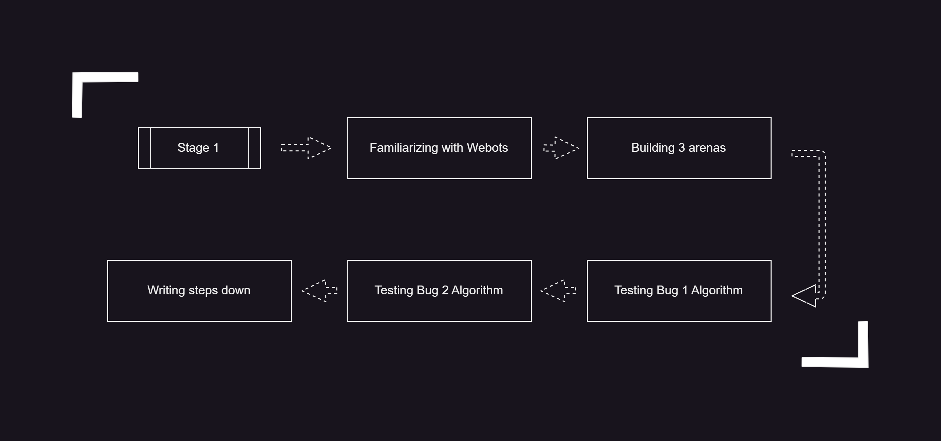
Testing

Slide 10
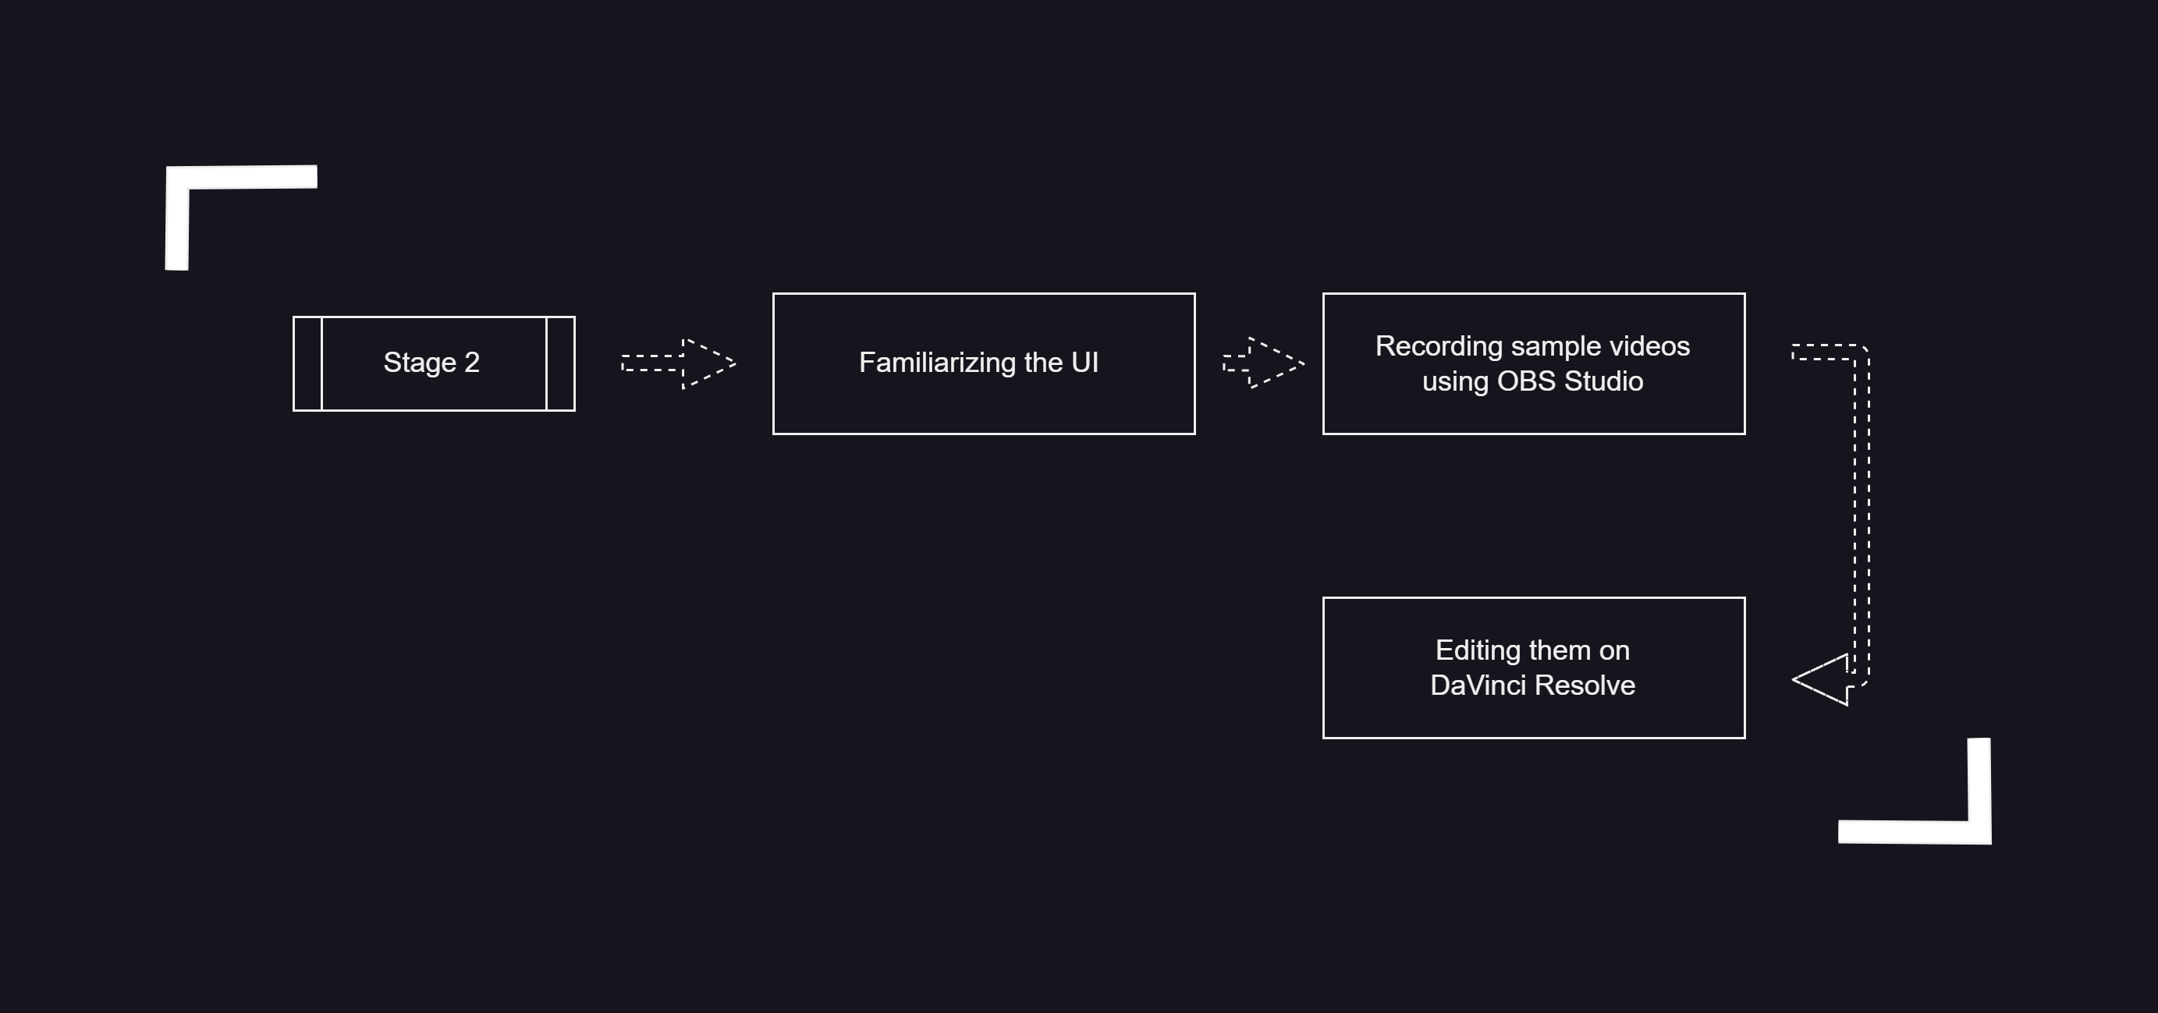
Testing

Slide 11
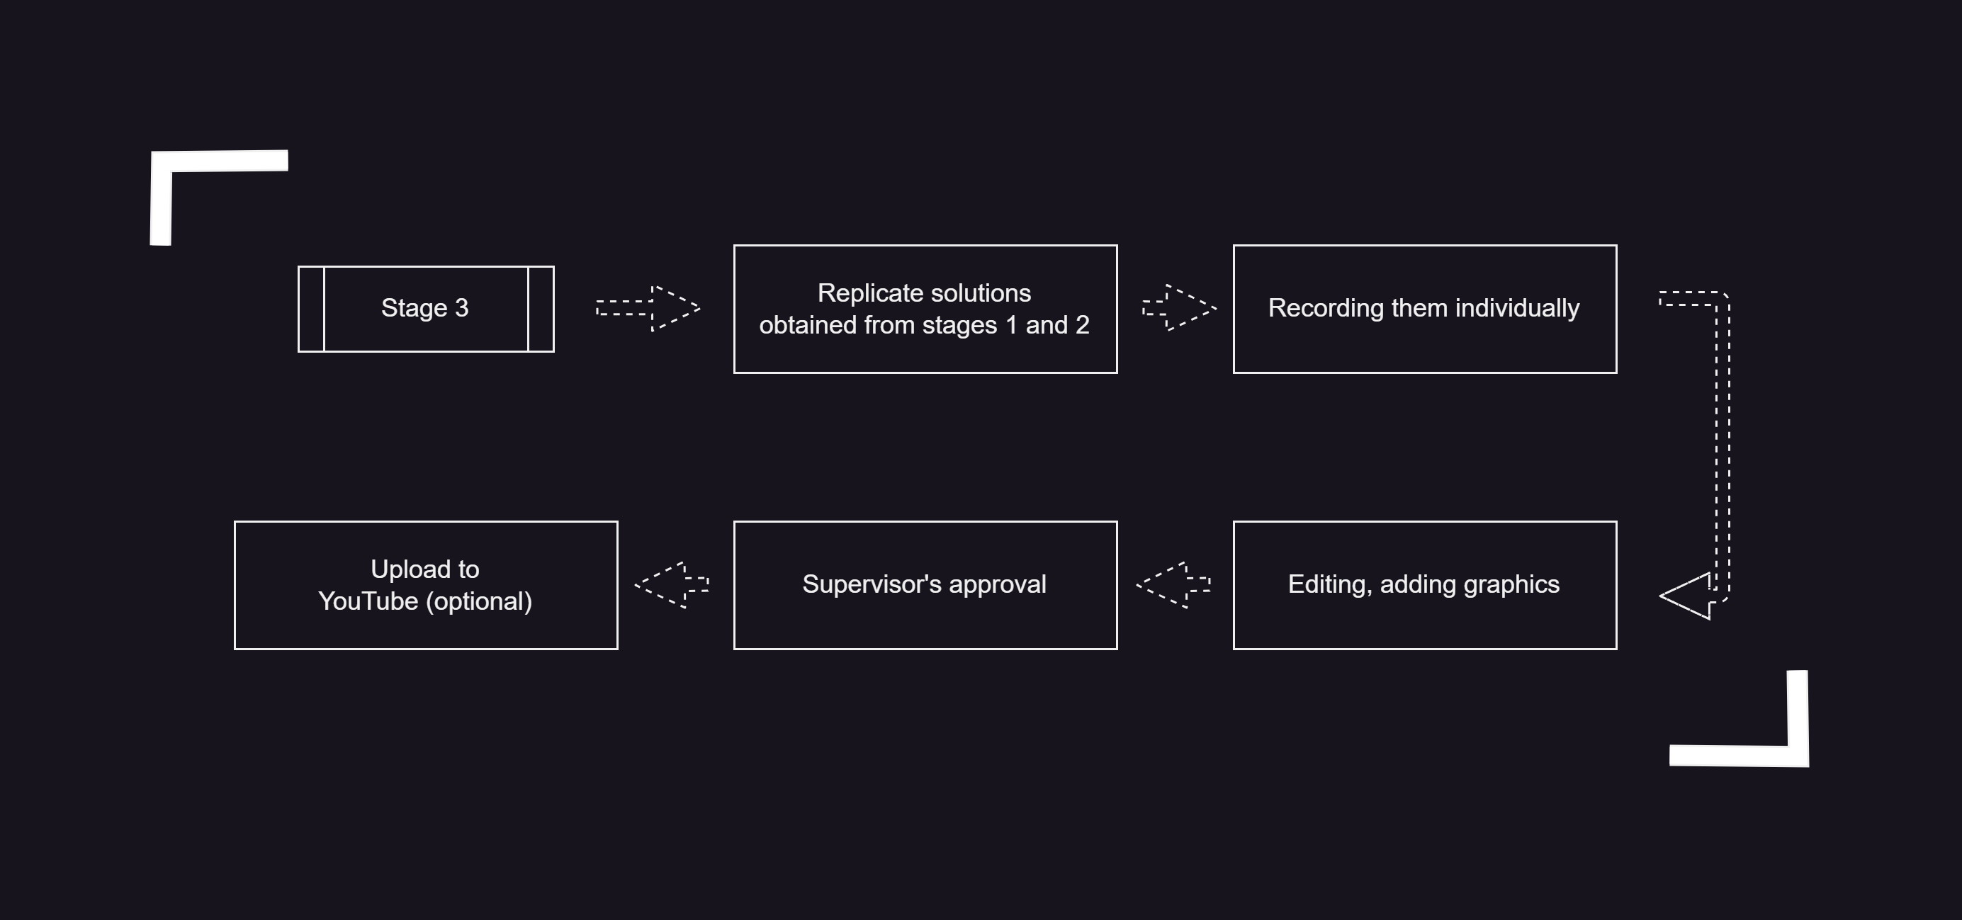
Testing

Slide 12
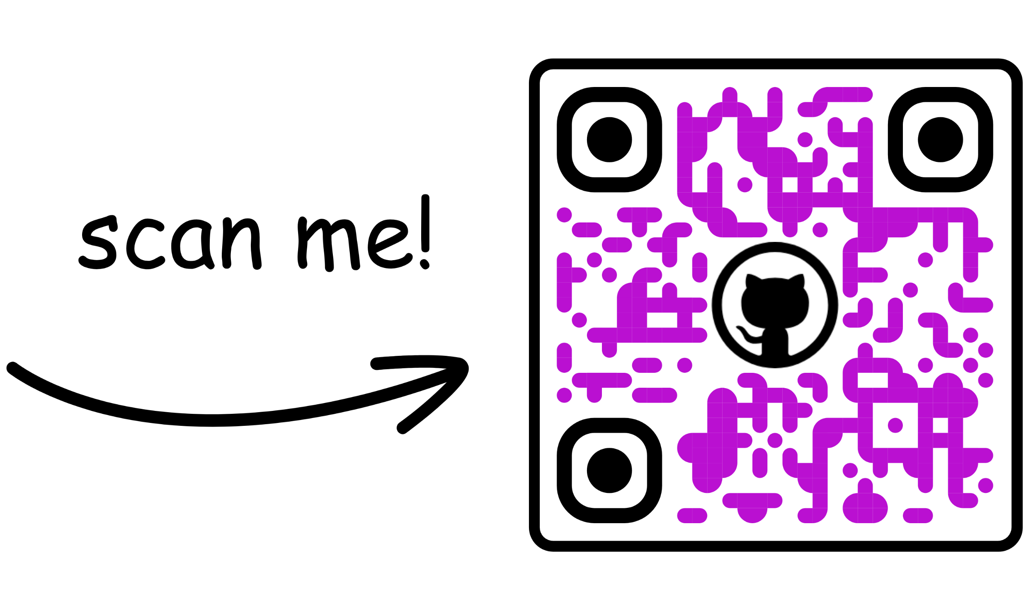
Project Plan

Slide 13
References
[1] “LecturesPlanningKinematics-FB+SLS.pdf,” ucsb.app.box.com. https://ucsb.app.box.com/v/LecturesRobotics(accessed Jul. 03, 2023).
[2] “WebotsDocumentation,” cyberbotics.com. https://cyberbotics.com/doc/guide/index
[3] “Author: Dion Scoppettuolo DaVinci Resolve 17 The Beginner’s Guide,”https://documents.blackmagicdesign.com/UserManuals/DaVinci-Resolve-17-Beginners-Guide.pdf
[4] “COMP329Autonomous Mobile Robotics,module coordinator -Dr Terry Payne,” fs.liverpool.ac.uk. https://canvas.liverpool.ac.uk/courses/59631(accessed Jul. 04, 2023).
[5]“TeamGantt–Online GANTT Chart maker,” app.teamgantt.com. https://app.teamgantt.com
[6]“Open Broadcaster Software | OBS,” Obsproject.com, 2012. https://obsproject.com/
[7]“GitHub,” GitHub, 2023. https://github.com/
[8] “QR code generator - free | Make QR code for link, image or PDF file - ME-QR,” me-qr.com. https://me-qr.com/
[9] Figma, “Figma: the collaborative interface design tool.,” Figma, 2022. https://www.figma.com/

